Slide 1


BIT07 – Machine Learning
Cedric Hermans

Slide 2
Machine Learning
Introduction to machine learning
Linear regression

Slide 3
Introduction to machine learning
What is ML?
Computers learning from data so that they can carry out certain tasks
Why ML?
Some tasks: easy to program/easy algorithms
Others: no easy algorithm solution => let computer explore the data
No human errors/biases

Slide 4
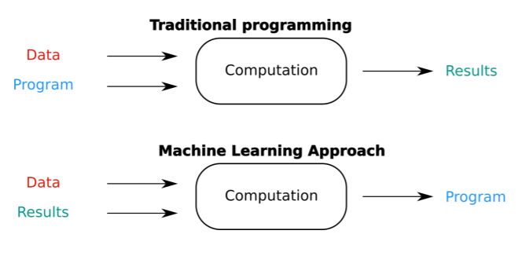
Introduction to machine learning

Slide 5
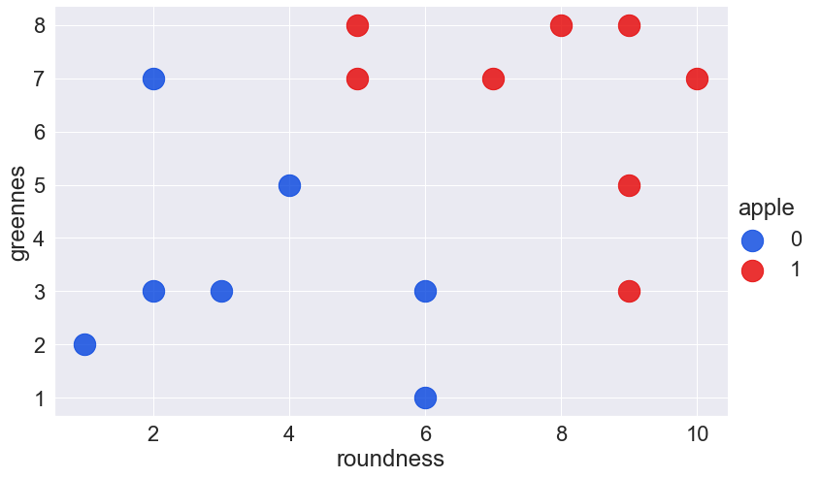
Introduction to machine learning

Slide 6
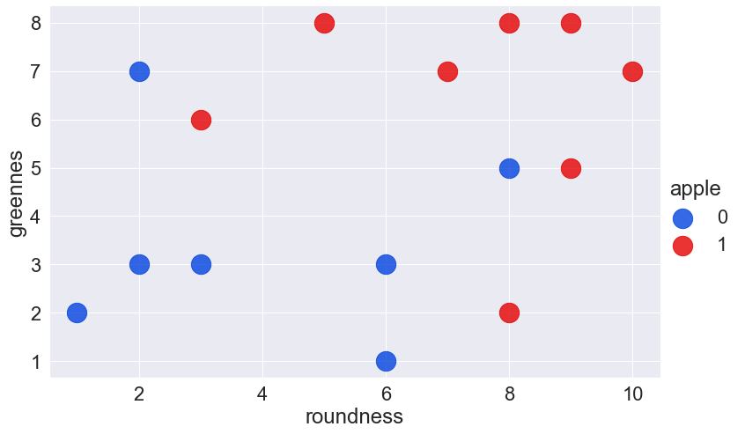
Introduction to machine learning

Slide 7
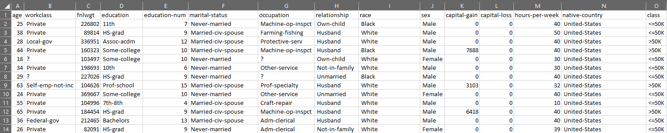

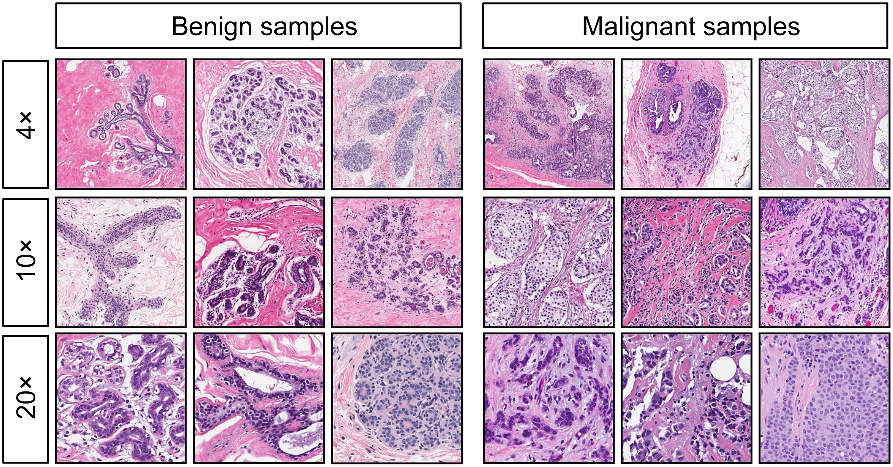
Introduction to machine learning

Slide 8

Introduction to machine learning

Slide 9


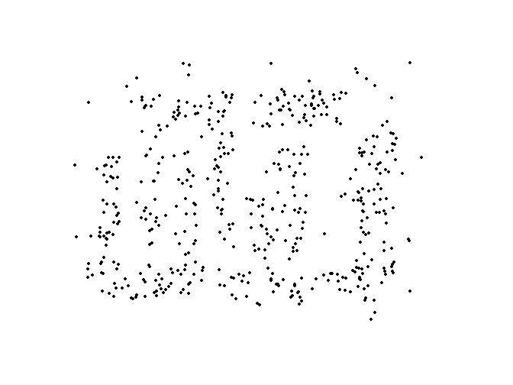
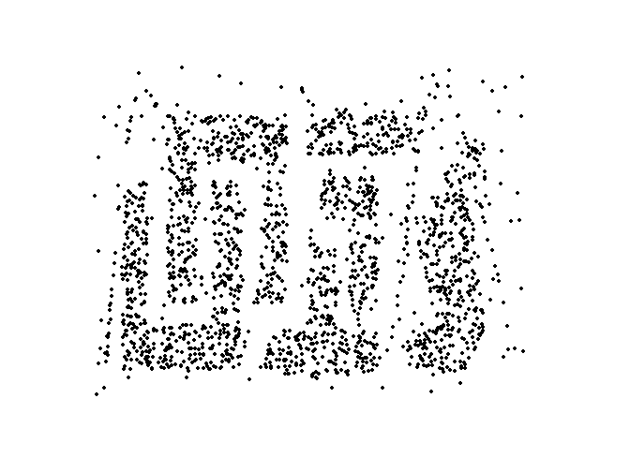


Introduction to machine learning
Why now?
Faster hardware
Better algorithms
More data
(Open source) frameworks
GEFORCE RTX 3090
https://6b.eleuther.ai/
8000 dots 2000 dots 500 dots
Visible pattern

Slide 10



Introduction to machine learning
3 main types of learning
Supervised | Unsupervised | Reinforcement
Inputs with desired outputs are given | Desired outputs are not given | Decision process is based on rewards
Task driven | Data driven (clustering) | Algorithm learns to react on its surroundings

Slide 11
Supervised learning
Learn based on labeled training set.
Algorithm gets the dataset with the correct answers
Sepal length(cm) | Sepal width (cm) | Petal length (cm) | Petal width (cm) | Class
5.1 | 3.5 | 1.4 | 0.2 | Iris-setosa
4.9 | 3.0 | 1.4 | 0.2 | Iris-setosa
4.7 | 3.2 | 1.3 | 0.2 | Iris-setosa
7.0 | 3.2 | 4.7 | 1.4 | Iris-versicolor
6.4 | 3.2 | 4.5 | 1.5 | Iris-versicolor
6.9 | 3.1 | 4.9 | 1.5 | Iris-versicolor
6.3 | 3.3 | 6.0 | 2.5 | Iris-virginica
5.8 | 2.7 | 5.1 | 1.9 | Iris-virginica
7.1 | 3.0 | 5.9 | 2.1 | Iris-virginica

Slide 12



Supervised learning
Learn based on labeled training set.
Algorithm gets the dataset with the correct answers
Training
Sepal length(cm)
Sepal width (cm)
Petal length (cm)
Petal width (cm)
5.1
Actual: Iris-setosa
3.5
Iris-versicolor
1.4
Iris-setosa
0.2

Slide 13
Supervised learning
Learn based on labeled training set.
Algorithm gets the dataset with the correct answers
Real world application
Sepal length(cm)
Sepal width (cm)
Petal length (cm)
Petal width (cm)
5.1
3.5
1.4
Iris-setosa
0.2

Slide 14
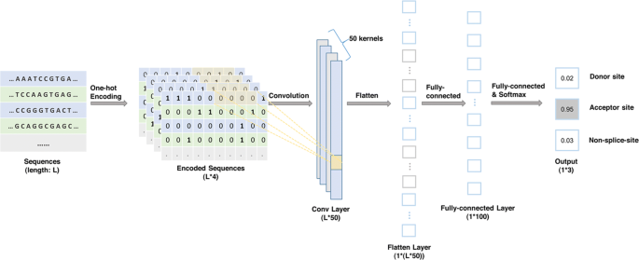
Supervised learning - examples

Slide 15
Supervised learning - examples
Gene prediction
A dataset with known promotors, exons, introns, splice sites…
Create and train a model that is able to recognize a gene as good as possible
Use the model on a new genome to identify genes
E.g.: GENSCAN: http://hollywood.mit.edu/GENSCAN.html

Slide 16
Unsupervised learning
Learn based on unlabeled training set.
Algorithm divides data in clusters that best describe the dataset
Training
Sepal length(cm)
Sepal width (cm)
Petal length (cm)
Petal width (cm)
5.1
3.5
1.4
Cluster 1
0.2

Slide 17
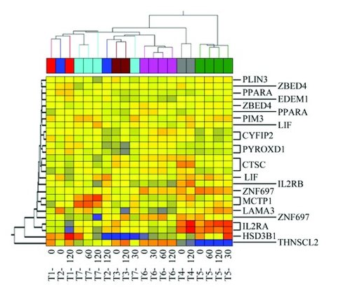
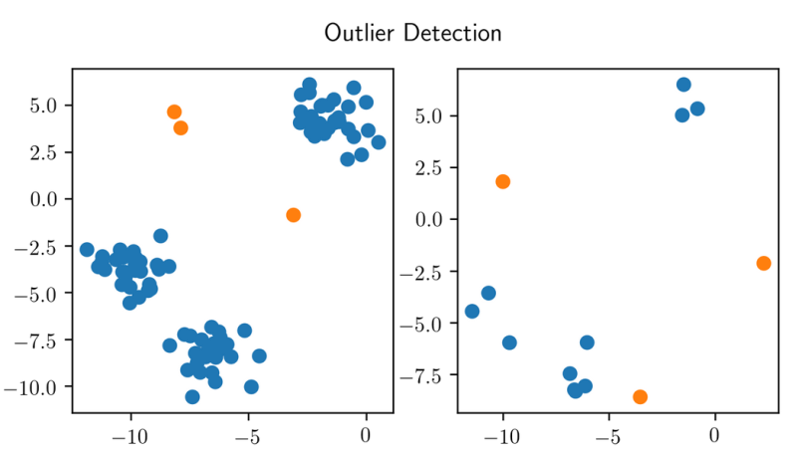
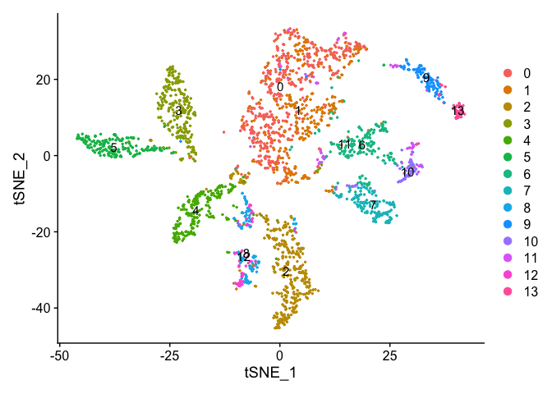
Unsupervised learning - examples
Clustering Anomaly detection Dimensionality reduction

Slide 18
Reinforcement learning
Learns from trial and error
Less used in bioinformatics
https://www.youtube.com/watch?v=kopoLzvh5jY

Slide 19
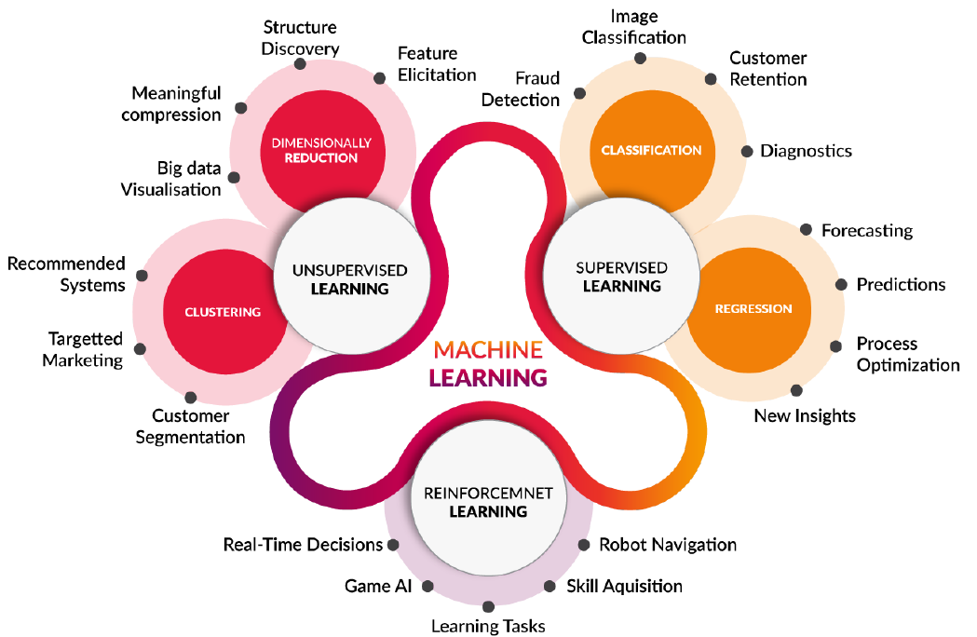
Overview learning algorithms

Slide 20
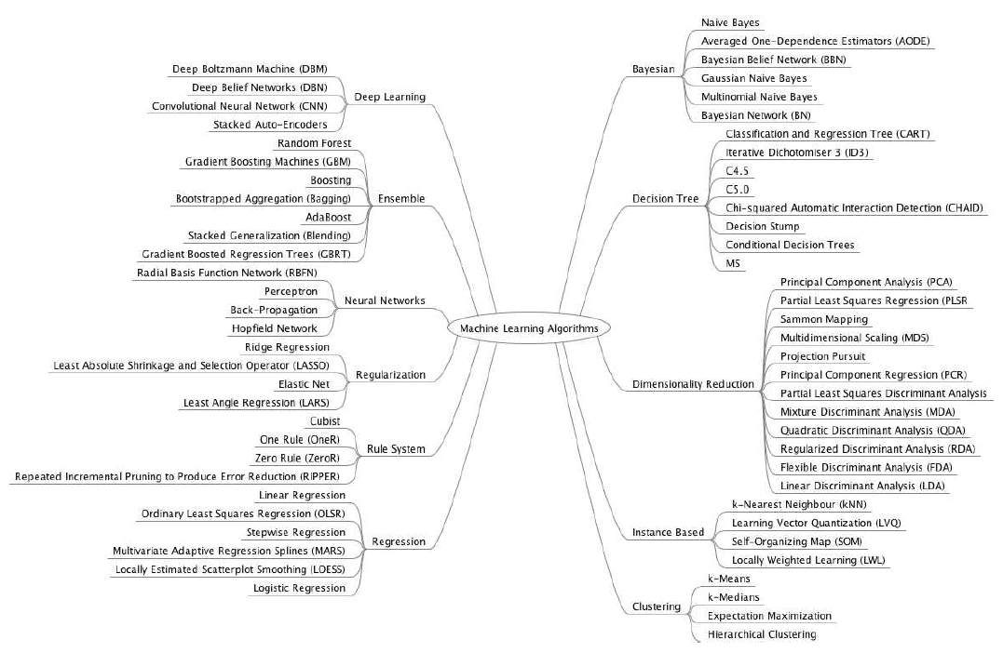
Overview learning algorithms
+t-SNE

Slide 21
Approach to machine learning project
Raw data
Pre-processing
Candidate model
Prepared data
Apply learning algorithm
Chosen model
Data collection
Iterate to find the best model

Slide 22
Regression
What is regression?
A method of modelling a target value based on independent predictors
Advertisement cost | Sales
€90 | €1000
€120 | €1300
€150 | €1800
€100 | €1200
€130 | €1380
€200 | ?

Slide 23
Regression
Regression applications

Slide 24
Linear regression
 | age | weight | blood pressure
0 | 52 | 78 | 136
1 | 59 | 83 | 143
2 | 67 | 88 | 153
3 | 73 | 96 | 162
4 | 64 | 89 | 161
5 | 74 | 103 | 171
6 | 54 | 85 | 137
7 | 61 | 85 | 149
8 | 65 | 94 | 162
9 | 46 | 76 | 128
10 | 72 | 98 | 166
Predict the blood pressure based on age and weight
Features: age and weight
Target: blood pressure
Trainingset: 11 training examples
In linear regression, the output/target is a continuous variable

Slide 25
Linear regression

Slide 26
Linear regression
Find a relationship between weight and blood pressure
Linear trend line as a model h_{θ}(x) (=hypotheses)

Slide 27
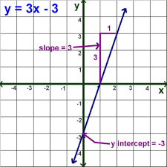
Linear regression
Find a relationship between weight and blood pressure
The relationship (=hypothesis) h_{θ}(x) is formulated as:
h_{θ}(x) = θ₀ + θ₁x
Determine the optimal values of θ₀ and θ₁
θ₀ = intercept with the y-axis
θ₁ = slope of the trend line
The parameters θ_{i} are called weights
Searching the best values for the model/hypothesis = training/learning
In mathematics:
y=b+mx

Slide 28
Linear regression
Find a relationship between weight and blood pressure
How do we find the optimal values for θ₀ and θ₁?

Slide 29
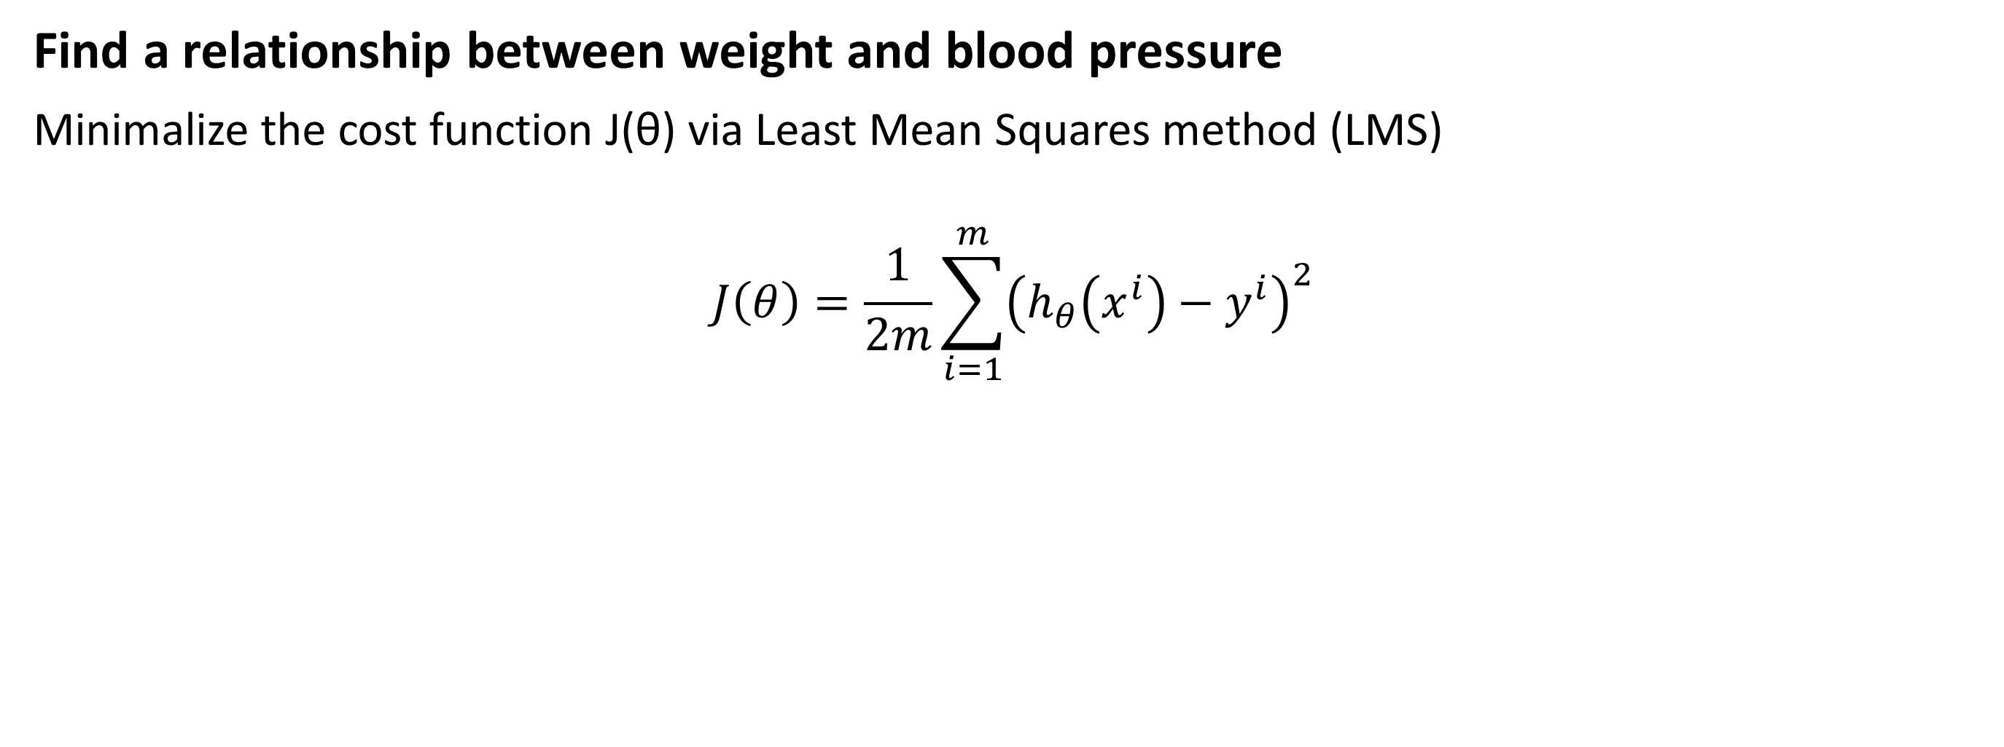
Linear regression
Find a relationship between weight and blood pressure
Minimalize the cost function J(θ) via Least Mean Squares method (LMS)
$$J\left(θ\right)=\frac{1}{2m}\sum_{i=1}^{m}{{\left(h_{θ}\left(x^{i}\right)−y^{i}\right)}^{2}}$$
Notes:
J= a weighted value of the sum of squared errors
The error = hθ(x^{i})-y^{i} = predicted value – absolute value

Slide 30
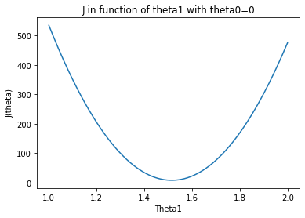
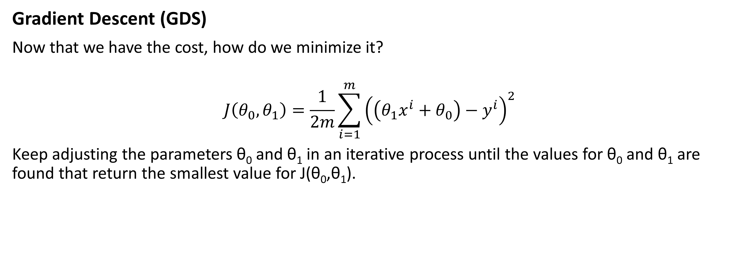
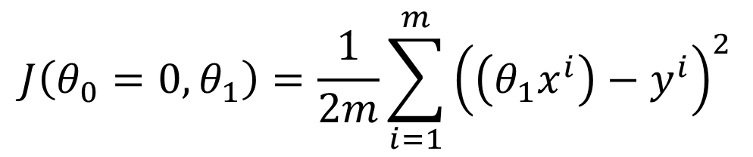
Linear regression
Gradient Descent (GDS)
Now that we have the cost, how do we minimize it?
$$J\left(θ_{0},θ_{1}\right)=\frac{1}{2m}\sum_{i=1}^{m}{{\left(\left(θ_{1}x^{i}+θ_{0}\right)−y^{i}\right)}^{2}}$$
Keep adjusting the parameters θ₀ and θ₁ in an iterative process until the values for θ₀ and θ₁ are found that return the smallest value for J(θ₀,θ₁).
$$J\left(θ_{0}=0,θ_{1}\right)=\frac{1}{2m}\sum_{i=1}^{m}{{\left(\left(θ_{1}x^{i}\right)−y^{i}\right)}^{2}}$$

Slide 31
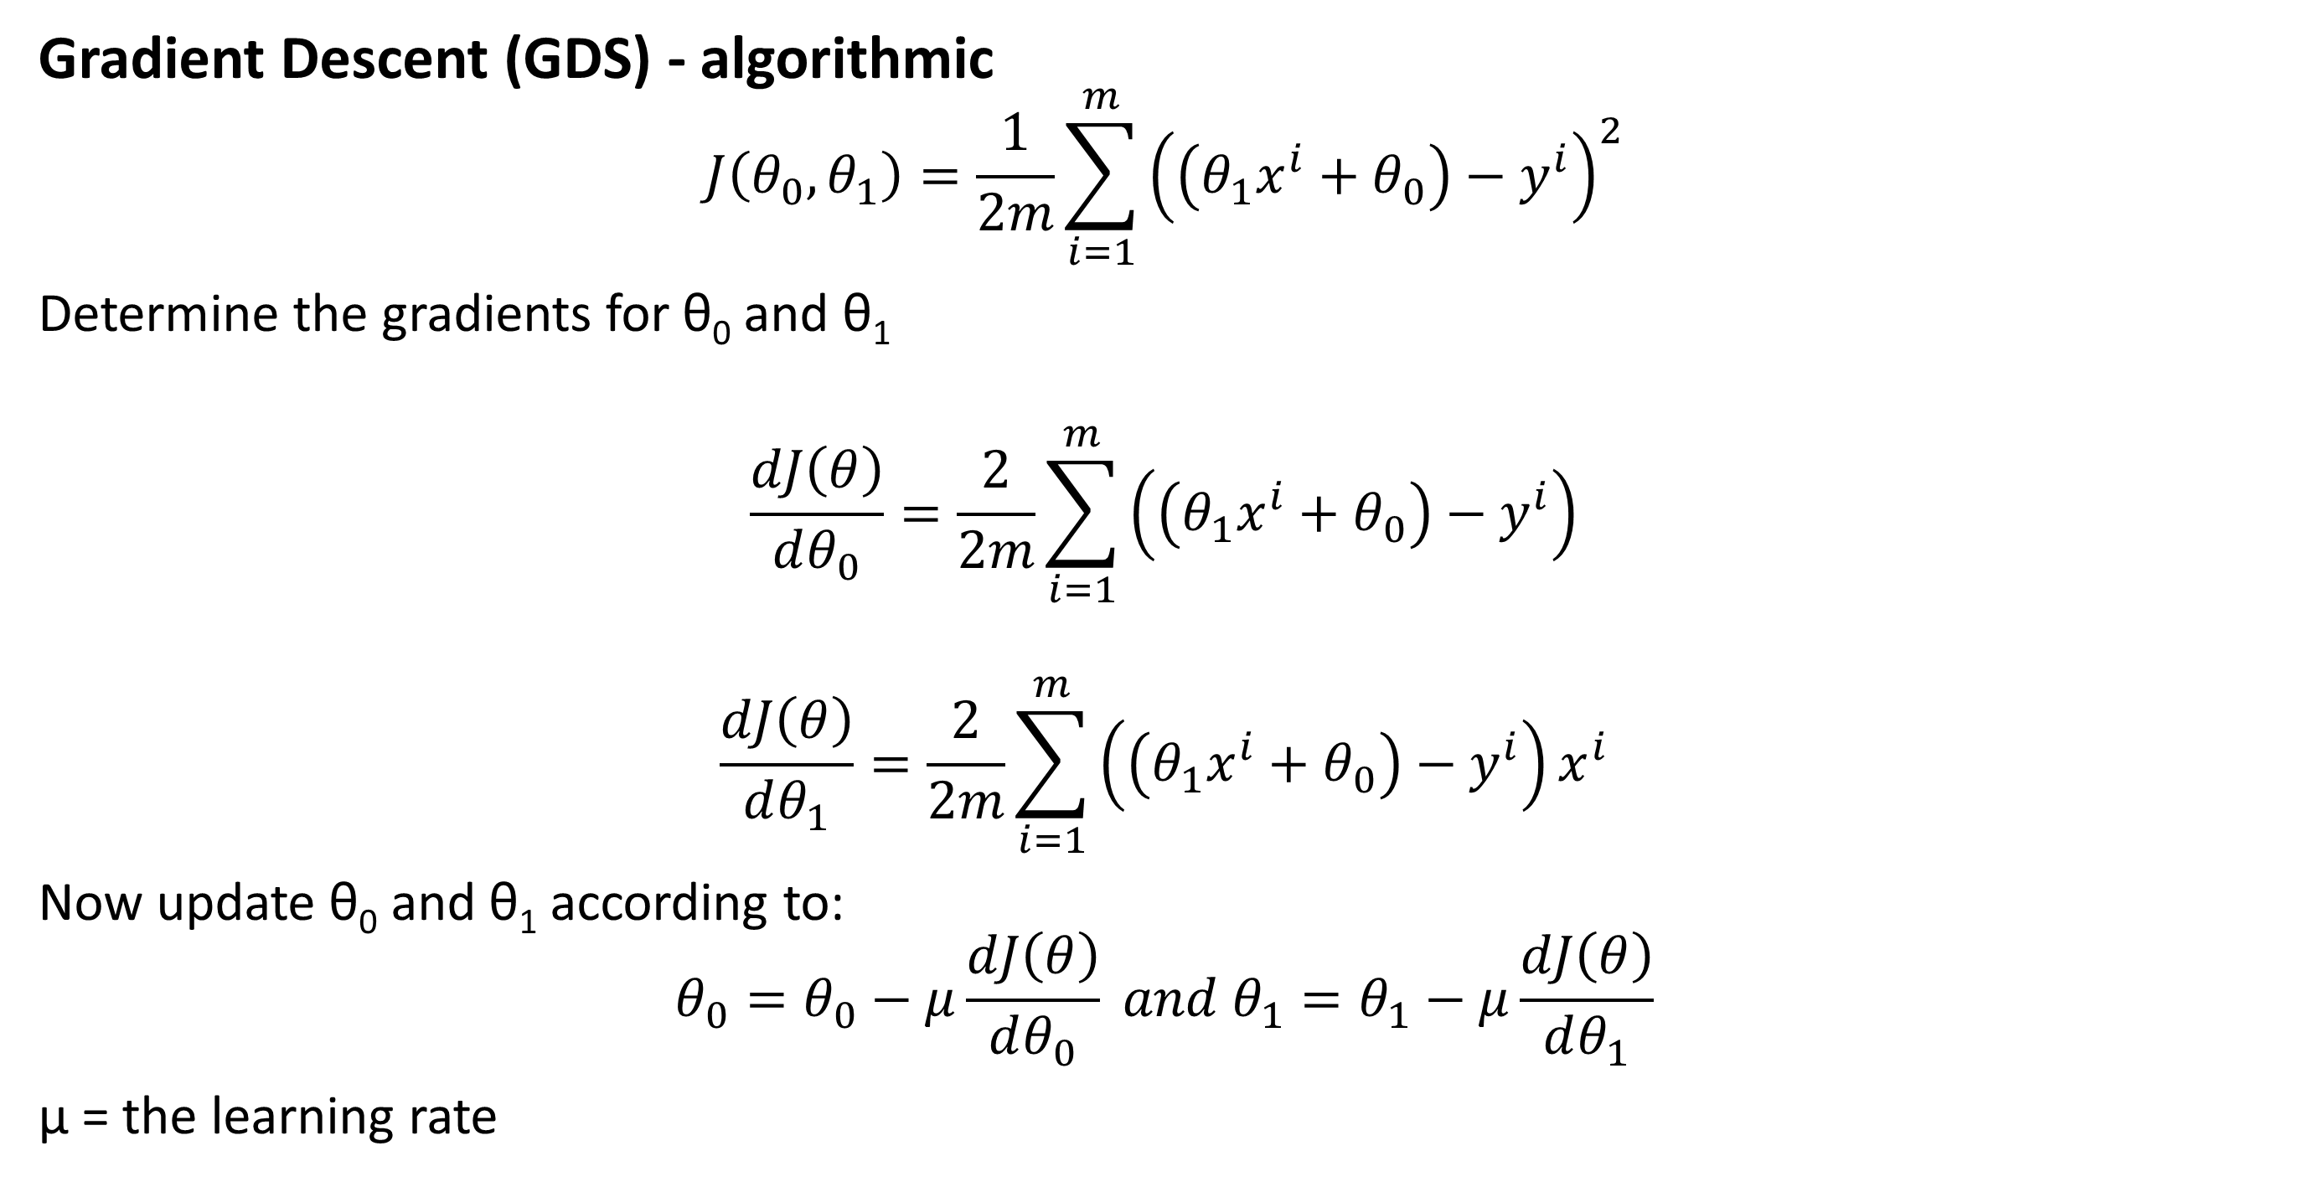
Linear regression
Gradient Descent (GDS) - algorithmic
$$J\left(θ_{0},θ_{1}\right)=\frac{1}{2m}\sum_{i=1}^{m}{{\left(\left(θ_{1}x^{i}+θ_{0}\right)−y^{i}\right)}^{2}}$$
Determine the gradients for θ₀ and θ₁
$$\frac{dJ\left(θ\right)}{dθ_{0}}=\frac{2}{2m}\sum_{i=1}^{m}{\left(\left(θ_{1}x^{i}+θ_{0}\right)−y^{i}\right)}$$
$$\frac{dJ\left(θ\right)}{dθ_{1}}=\frac{2}{2m}\sum_{i=1}^{m}{\left(\left(θ_{1}x^{i}+θ_{0}\right)−y^{i}\right)x^{i}}$$
Now update θ₀ and θ₁ according to:
$$θ_{0}=θ_{0}−μ\frac{dJ\left(θ\right)}{dθ_{0}} and θ_{1}=θ_{1}−μ\frac{dJ\left(θ\right)}{dθ_{1}}$$
μ = the learning rate

Slide 32
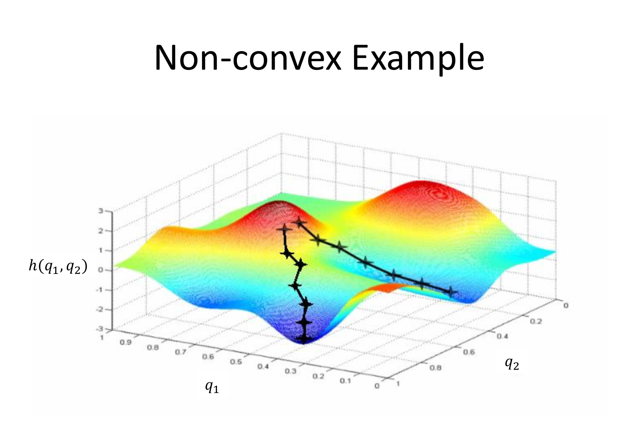
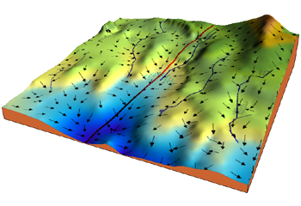
Linear regression
Gradient Descent (GDS)
Just like water following the path of least resistance (= biggest slope), now the path of lowest cost is followed
Local vs global optimum

Slide 33
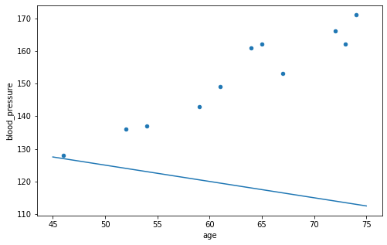
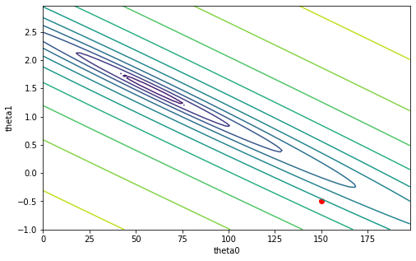
Linear regression
Gradient Descent (GDS)

Slide 34
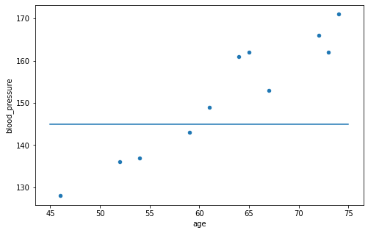
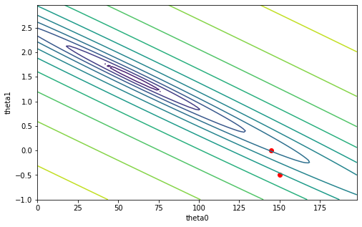
Linear regression
Gradient Descent (GDS)

Slide 35
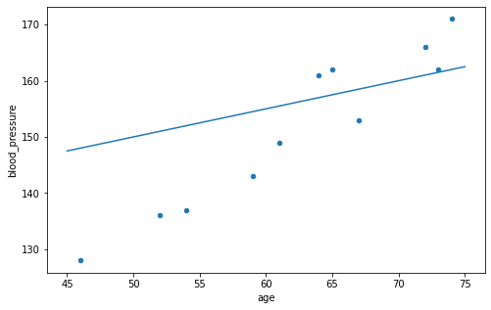

Linear regression
Gradient Descent (GDS)

Slide 36
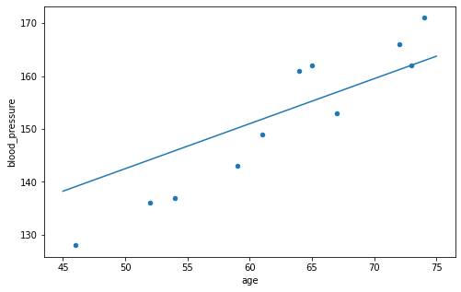

Linear regression
Gradient Descent (GDS)

Slide 37
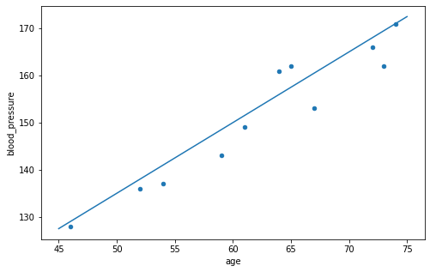

Linear regression
Gradient Descent (GDS)

Slide 38
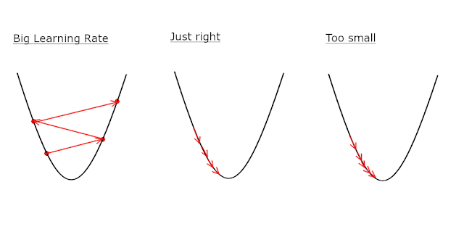
Linear regression
Gradient Descent (GDS) – Learning rate

Slide 39
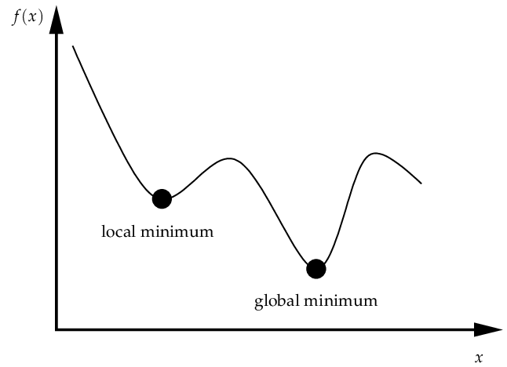
Linear regression
Gradient Descent (GDS) – Learning rate

Slide 40
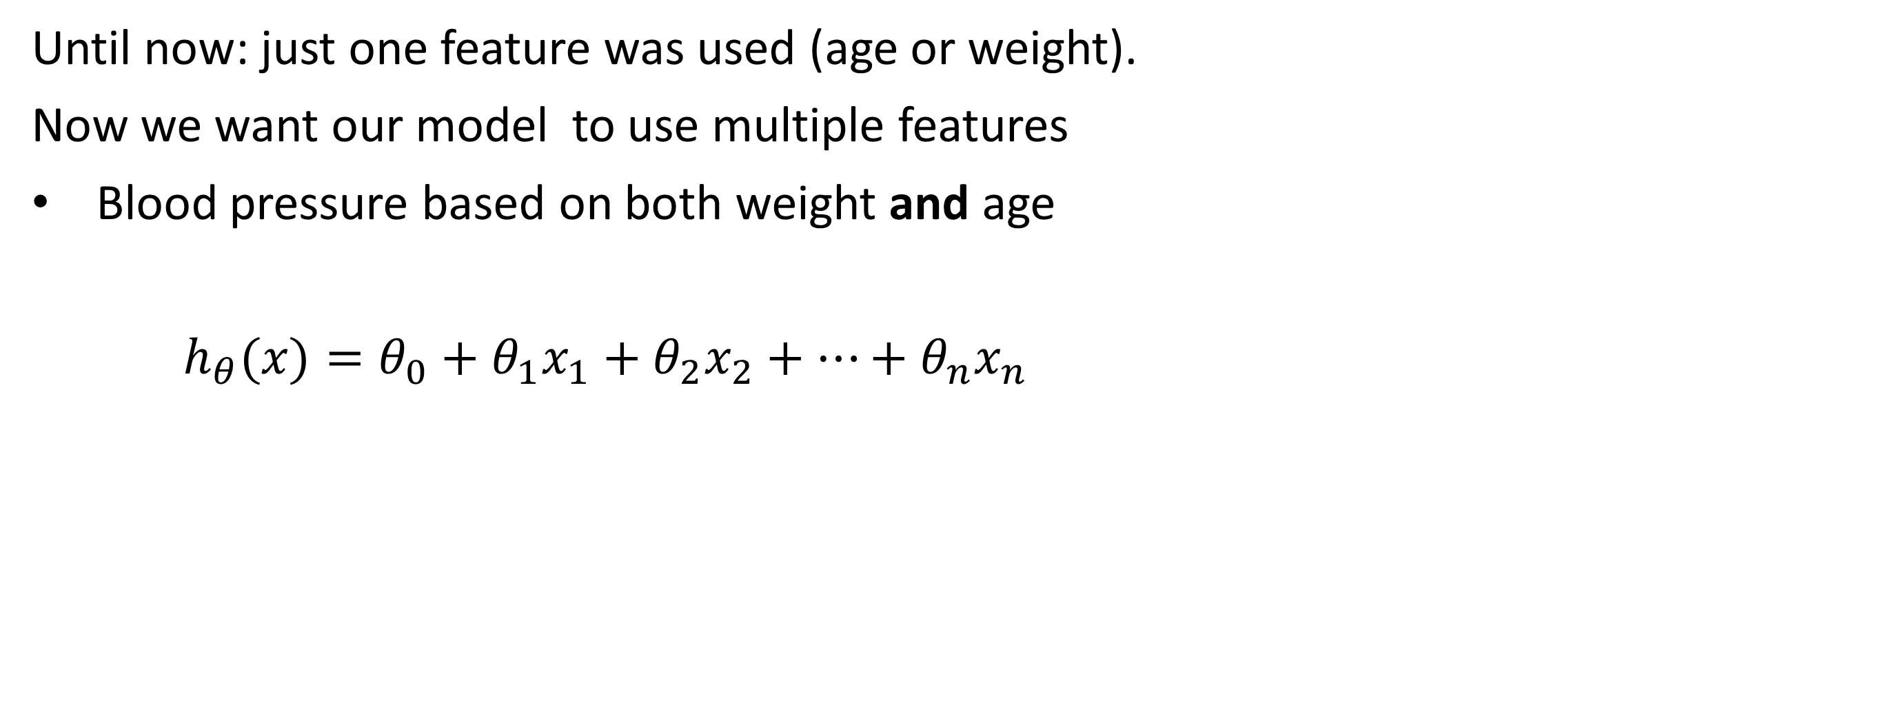
Multivariate linear regression
Until now: just one feature was used (age or weight).
Now we want our model to use multiple features
Blood pressure based on both weight and age
$h_{θ}(x)=θ_{0}+θ_{1}x_{1}+θ_{2}x_{2}+…+θ_{n}x_{n}$
 | age | weight | blood pressure
0 | 52 | 78 | 136
1 | 59 | 83 | 143
2 | 67 | 88 | 153
3 | 73 | 96 | 162
4 | 64 | 89 | 161
5 | 74 | 103 | 171
6 | 54 | 85 | 137
7 | 61 | 85 | 149
8 | 65 | 94 | 162
9 | 46 | 76 | 128
10 | 72 | 98 | 166

Slide 41
Multivariate linear regression
Determine the house price based on certain features
Description of features: https://www.kaggle.com/c/boston-housing
 | CRIM | ZN | INDUS | CHAS | NOX | RM | AGE | DIS | RAD | TAX | PT | B | LSTAT | Price
0 | 0,01 | 18,00 | 2,31 | 0 | 0,54 | 6,58 | 65,20 | 4,09 | 1 | 296 | 15,30 | 396,90 | 4,98 | 504,00
1 | 0,03 | 0 | 7,07 | 0 | 0,47 | 6,42 | 78,90 | 4,97 | 2 | 242 | 17,80 | 396,90 | 9,14 | 453,60
2 | 0,03 | 0 | 7,07 | 0 | 0,47 | 7,19 | 61,10 | 4,97 | 2 | 242 | 17,80 | 392,83 | 4,03 | 728,70
3 | 0,03 | 0 | 2,18 | 0 | 0,46 | 7,00 | 45,80 | 6,06 | 3 | 222 | 18,70 | 394,63 | 2,94 | 701,40
4 | 0,07 | 0 | 2,18 | 0 | 0,46 | 7,15 | 54,20 | 6,06 | 3 | 222 | 18,70 | 396,90 | 5,33 | 760,20

Slide 42
Multivariate linear regression
Check the consistency of the dataset
df.describe()
Since CHAS is always = 0, we can remove this column
data.drop("CHAS",axis=1,inplace=True)
 | CRIM | ZN | INDUS | CHAS | NOX | RM | AGE | DIS | RAD | TAX | PT | B | LSTAT | Price
count | 506 | 506 | 506 | 506 | 506 | 506 | 506 | 506 | 506 | 506,00 | 506,00 | 506,00 | 506,00 | 506,00
mean | 4,67 | 11,36 | 11,14 | 0 | 25,89 | 87,23 | 68,57 | 11,45 | 9,55 | 408,24 | 18,46 | 356,67 | 12,65 | 473,19
std | 25,22 | 23,32 | 6,86 | 0 | 132,09 | 747,12 | 28,15 | 172,11 | 8,71 | 168,54 | 2,16 | 91,29 | 7,14 | 193,14
min | 0,01 | 0 | 0,46 | 0 | 0,39 | 3,56 | 2,90 | 1,13 | 1 | 187,00 | 12,60 | 0,32 | 1,73 | 105,00
25% | 0,08 | 0 | 5,19 | 0 | 0,45 | 5,89 | 45,03 | 2,10 | 4 | 279,00 | 17,40 | 375,38 | 6,95 | 357,53
50% | 0,26 | 0 | 9,69 | 0 | 0,54 | 6,21 | 77,50 | 3,21 | 5 | 330,00 | 19,05 | 391,44 | 11,36 | 445,20
75% | 3,69 | 12,50 | 18,10 | 0 | 0,62 | 6,63 | 94,07 | 5,21 | 24 | 666,00 | 20,20 | 396,23 | 16,95 | 525,00
max | 537,00 | 100,00 | 27,74 | 0 | 713,00 | 8.375,00 | 100,00 | 3.875,00 | 24 | 711,00 | 22,00 | 396,90 | 37,97 | 1.050,00

Slide 43
Multivariate linear regression
Axis
data.drop(3,axis=0,inplace=True)
data.drop("CHAS",axis=1,inplace=True)
Axis = 1
 | CRIM | ZN | INDUS | CHAS | NOX | RM | AGE | DIS | RAD
0 | 0,01 | 18,00 | 2,31 | 0 | 0,54 | 6575,00 | 65,20 | 4,09 | 1
1 | 0,03 | 0 | 7,07 | 0 | 0,47 | 6421,00 | 78,90 | 4,97 | 2
2 | 0,03 | 0 | 7,07 | 0 | 0,47 | 7185,00 | 61,10 | 4,97 | 2
3 | 0,03 | 0 | 2,18 | 0 | 0,46 | 6998,00 | 45,80 | 6,06 | 3
4 | 0,07 | 0 | 2,18 | 0 | 0,46 | 7147,00 | 54,20 | 6,06 | 3
Axis = 0

Slide 44
Multivariate linear regression
Check the consistency of the dataset
Remove outliers (not always, e.g., when trying to detect outliers)
Outliers: values that are very different from normal values
Different ways of detecting outliers
Here: if values are within three standard deviations of the mean.
Z-score
A value that shows how many standard deviations the value differs from the mean.
E.g., Z = 1.5, then the value is 1.5 standard deviations higher than the mean.

Slide 45
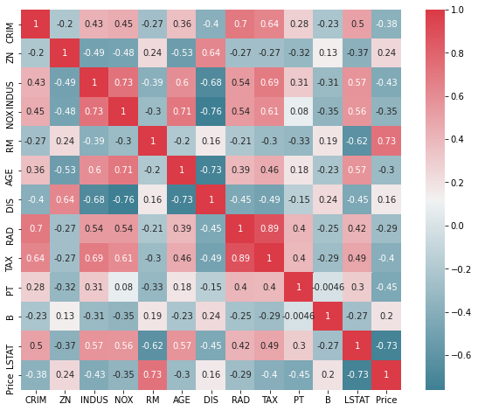
Multivariate linear regression
Check correlations in the dataset
Closer to 1: positive correlation
Closer to -1: negative correlation
Close to 0: no correlation

Slide 46
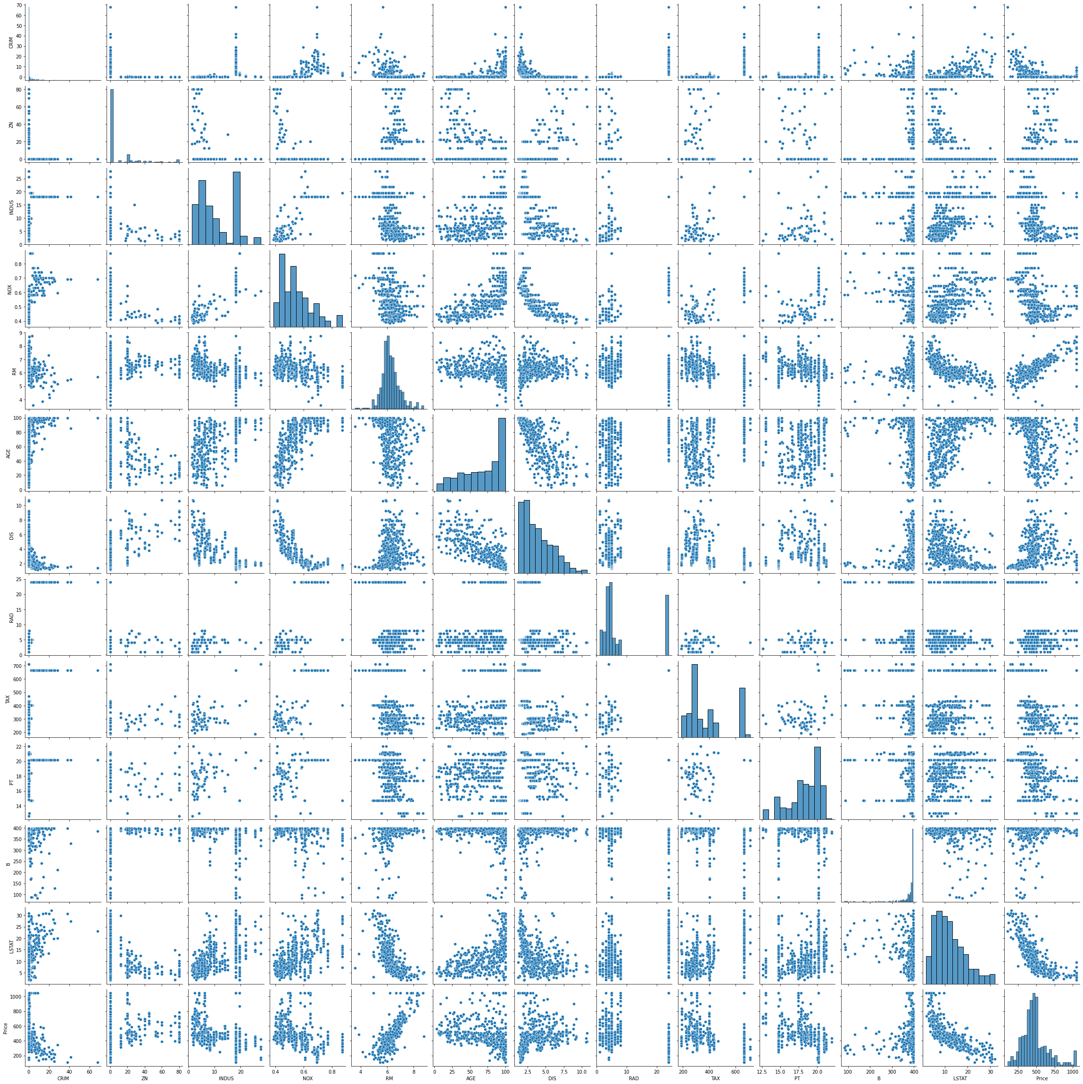
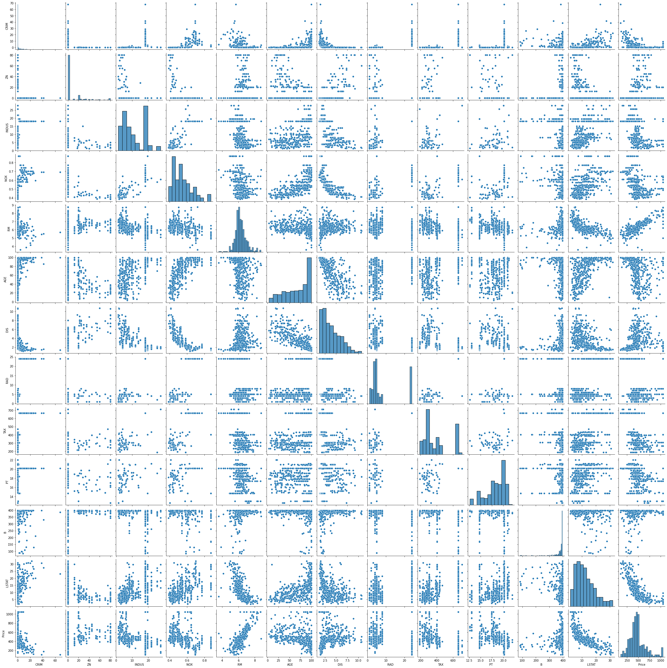
Multivariate linear regression
Check correlations in the dataset
Pairplot
See if there are correlations between 2 features

Slide 47
Multivariate linear regression
The terminology and code involved
Split data in features and targets
CRIM | ZN | INDUS | CHAS | NOX | RM | AGE | DIS | RAD | TAX | PT | B | LSTAT | Price
0,01 | 18,00 | 2,31 | 0 | 0,54 | 6,58 | 65,20 | 4,09 | 1 | 296 | 15,30 | 396,90 | 4,98 | 504,00
0,03 | 0 | 7,07 | 0 | 0,47 | 6,42 | 78,90 | 4,97 | 2 | 242 | 17,80 | 396,90 | 9,14 | 453,60
0,03 | 0 | 7,07 | 0 | 0,47 | 7,19 | 61,10 | 4,97 | 2 | 242 | 17,80 | 392,83 | 4,03 | 728,70
0,03 | 0 | 2,18 | 0 | 0,46 | 7,00 | 45,80 | 6,06 | 3 | 222 | 18,70 | 394,63 | 2,94 | 701,40
0,07 | 0 | 2,18 | 0 | 0,46 | 7,15 | 54,20 | 6,06 | 3 | 222 | 18,70 | 396,90 | 5,33 | 760,20
features X
targets y
# Split into features and targets
X = data_preprocessed.drop("Price",axis=1)
y = data_preprocessed["Price"]

Slide 48
Multivariate linear regression
The terminology and code involved
Split data in training and test set
Data
Training set
Test set
# Split data in train and test set
## train_test_split takes X, y, a test (or train size) and a random_state (=seed)
## This size can be the fraction (0.33) = 30% or an absolute number (1000)
## The seed allows you to always have the exact same split (useful for testing)
X_train, X_test, y_train, y_test = train_test_split(X, y, test_size=0.33, random_state=0)

Slide 49
Multivariate linear regression
The terminology and code involved
Split data in training and test set
Training data should only be used to train a model.
The testing data, should only be used to validate a model’s performance after training. This will help prevent overfitting.
Example of overfitting for classification:

Slide 50
Multivariate linear regression
The terminology and code involved
Initializing and training the regression model
# Create an empty model
lregmodel=linear_model.LinearRegression()
# Fit our training data on the model
lregmodel.fit(X_train,y_train)
# Resulting coefficients and intercept
print(f"Coefficients: {lregmodel.coef_}")
print(f"Intercept: {lregmodel.intercept_}")
Coefficients: [-3.56141289e+00 4.05479295e-01 8.14080284e-01 -2.70514977e+02 8.96450415e+01 -3.02997262e-01 -2.77339444e+01 7.47151897e+00 -2.92233040e-01 -1.61741146e+01 7.62044683e-02 -1.17962045e+01]
Intercept: 650.6520224880576
=> Predicted price = -3.561*CRIM + 0.405*ZN + 0.814*INDUS - 270.515*NOX + 89.645*RM - 0.303*AGE - 27.734*DIS + 7.472*RAD - 0.292*TAX - 16.174*PT + 0.076*B - 11.796*LSTAT + 650.6520224880576

Slide 51
Multivariate linear regression
The terminology and code involved
Predicting a new house value with given values:
CRIM | ZN | INDUS | NOX | RM | AGE | DIS | RAD | TAX | PT | B | LSTAT
0,04 | 80 | 4,95 | 0,41 | 6,63 | 23,40 | 5,12 | 4 | 245 | 19,20 | 396,90 | 4,70
house = np.array([0.04,80,4.95,0.41,6.63,23.40,5.12,4,245,19.20,396.90,4.70])
# The model expects an array of arrays to test: np.array(np.array(house1),np.array(house2),...)
# Now we just have an array of one house: np.array(house1). We need to reshape this data to be in
# the form: np.array(np.array(house1)). We do this with .reshape(1,-1)
price = lregmodel.predict(house.reshape(1,-1))
print(price)
[643.87453301]
Actual price: 585.50

Slide 52
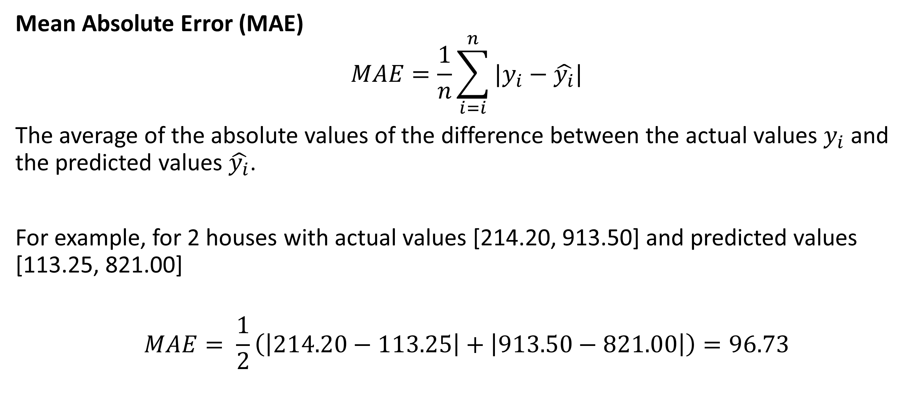
Testing a model
Mean Absolute Error (MAE)
$$MAE=\frac{1}{n}\sum_{i=i}^{n}{|y_{i}−\hat{y_{i}}|}$$
The average of the absolute values of the difference between the actual values $y_{i}$ and the predicted values $\hat{y_{i}}$.
For example, for 2 houses with actual values [214.20, 913.50] and predicted values [113.25, 821.00]
$$MAE= \frac{1}{2}\left(\left|214.20−113.25\right|+\left|913.50−821.00\right|\right)=96.73$$

Slide 53
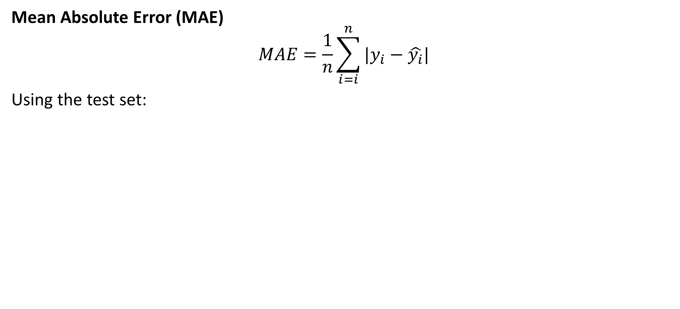
Testing a model
Mean Absolute Error (MAE)
$$MAE=\frac{1}{n}\sum_{i=i}^{n}{|y_{i}−\hat{y_{i}}|}$$
Using the test set:
from sklearn.metrics import mean_absolute_error
y_pred = lregmodel.predict(X_test)
print(f"MAE: {mean_absolute_error(y_test,y_pred)}")
MAE: 64.00908675904181

Slide 54
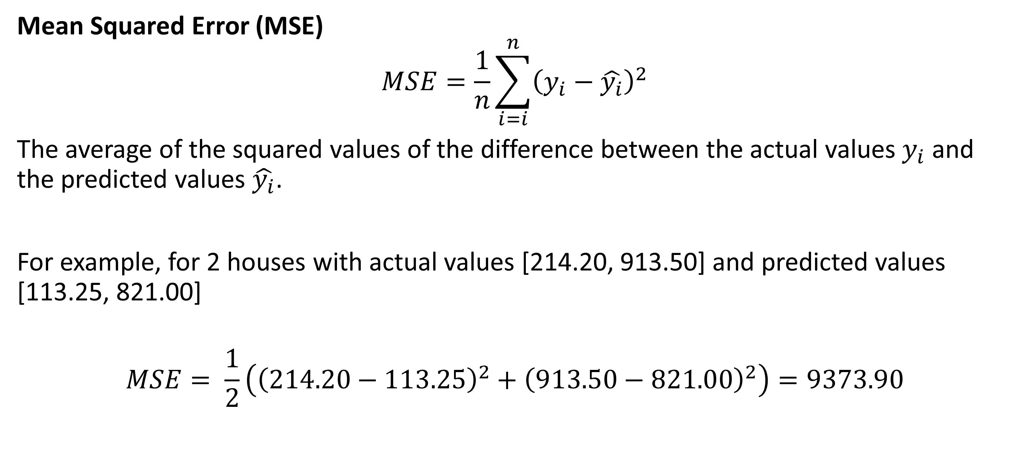
Testing a model
Mean Squared Error (MSE)
$$MSE=\frac{1}{n}\sum_{i=i}^{n}{{\left(y_{i}−\hat{y_{i}}\right)}^{2}}$$
The average of the squared values of the difference between the actual values $y_{i}$ and the predicted values $\hat{y_{i}}$.
For example, for 2 houses with actual values [214.20, 913.50] and predicted values [113.25, 821.00]
$$MSE= \frac{1}{2}\left({\left(214.20−113.25\right)}^{2}+{\left(913.50−821.00\right)}^{2}\right)=9373.90$$

Slide 55
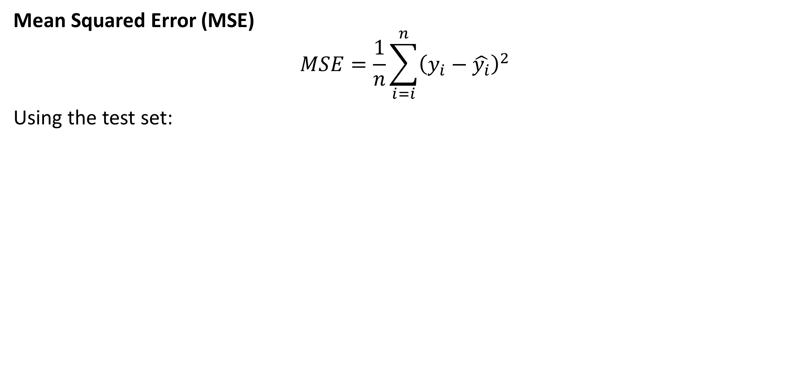
Testing a model
Mean Squared Error (MSE)
$$MSE=\frac{1}{n}\sum_{i=i}^{n}{{\left(y_{i}−\hat{y_{i}}\right)}^{2}}$$
Using the test set:
from sklearn.metrics import mean_squared_error
y_pred = lregmodel.predict(X_test)
print(f"MSE: {mean_squared_error(y_test,y_pred)}")
MSE: 7803.893327604376

Slide 56
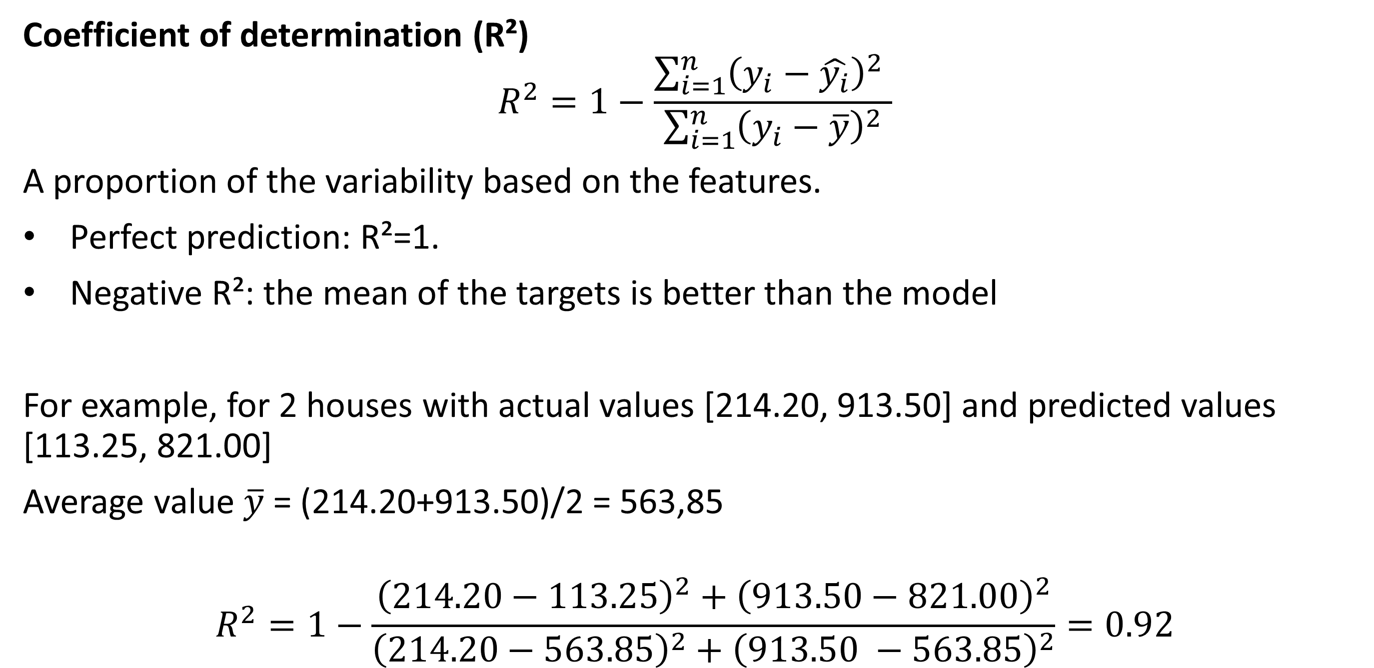
Testing a model
Coefficient of determination (R²)
$$R^{2}=1−\frac{\sum_{i=1}^{n}{{\left(y_{i}−\hat{y_{i}}\right)}^{2} }}{\sum_{i=1}^{n}{{\left(y_{i}−\overline{y}\right)}^{2}}}$$
A proportion of the variability based on the features.
Perfect prediction: R²=1.
Negative R²: the mean of the targets is better than the model
For example, for 2 houses with actual values [214.20, 913.50] and predicted values [113.25, 821.00]
Average value $\overline{y}$ = (214.20+913.50)/2 = 563,85
$$R^{2}=1−\frac{{\left(214.20−113.25\right)}^{2}+{\left(913.50−821.00\right)}^{2}}{{\left(214.20−563.85\right)}^{2}+{\left(913.50 −563.85\right)}^{2}}=0.92$$

Slide 57
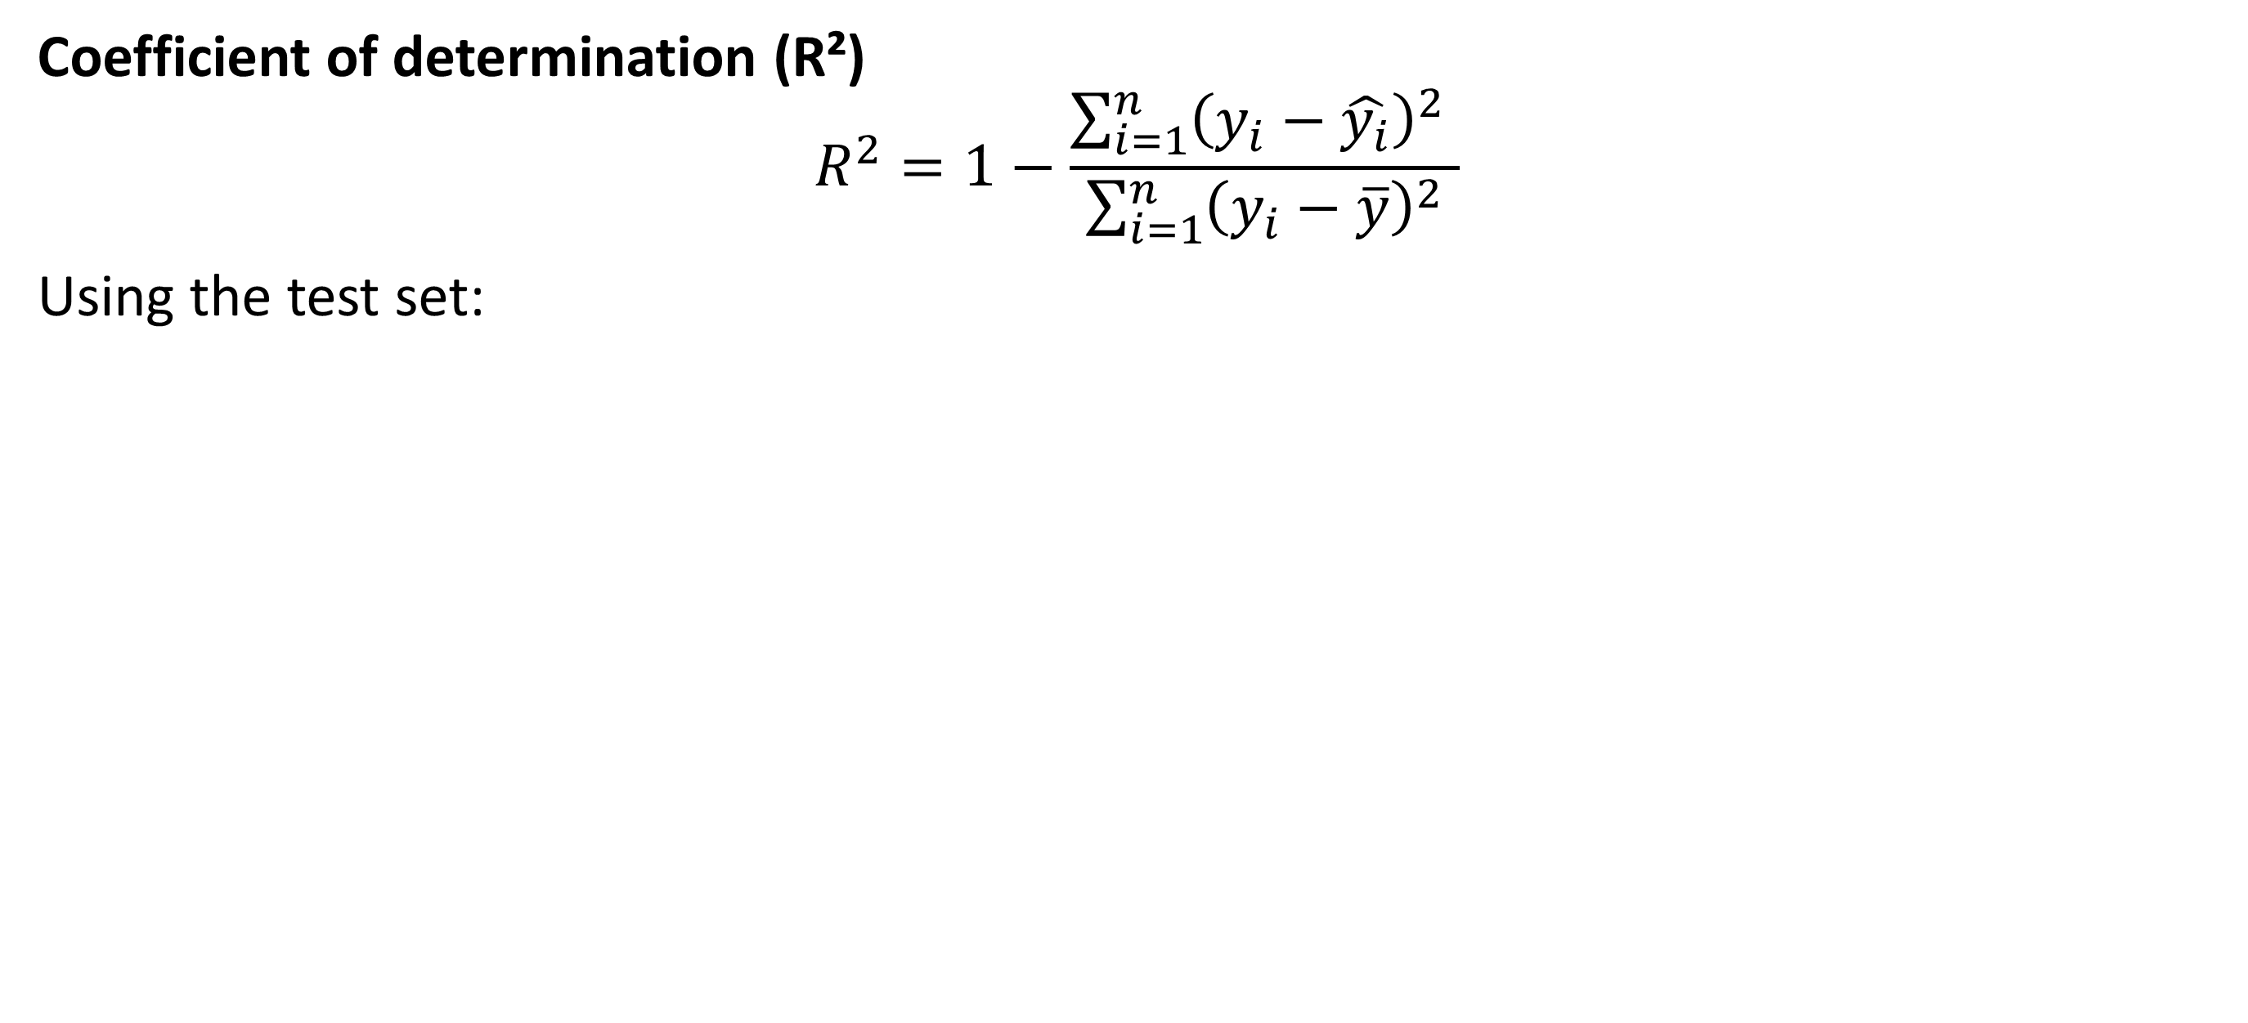
Testing a model
Coefficient of determination (R²)
$$R^{2}=1−\frac{\sum_{i=1}^{n}{{\left(y_{i}−\hat{y_{i}}\right)}^{2} }}{\sum_{i=1}^{n}{{\left(y_{i}−\overline{y}\right)}^{2}}}$$
Using the test set:
from sklearn.metrics import r2_score
y_pred = lregmodel.predict(X_test)
print(f"R2: {r2_score(y_test,y_pred)}")
R2 : 0.7542542349129899
# Alternatively, R2 can also be calculated with the model:
print(f"R2 : {lregmodel.score(X_test,y_test)}")

Slide 58
Normalization
Normalization makes sure that the features have the same scale.
E.g.
AGE: 2,90 -> 100,00
NOX: 0,39 -> 0,87
 | CRIM | ZN | INDUS | NOX | RM | AGE | DIS | RAD | TAX | PT | B | LSTAT | Price
count | 441 | 441 | 441 | 441 | 441 | 441 | 441 | 441 | 441 | 441 | 441 | 441 | 441
mean | 2,65 | 9,99 | 10,76 | 0,55 | 6,27 | 67,63 | 3,85 | 8,48 | 389,05 | 18,39 | 375,39 | 12,17 | 478,79
std | 6,27 | 19,94 | 6,75 | 0,11 | 0,69 | 28,00 | 2,05 | 8,00 | 158,29 | 2,16 | 49,30 | 6,63 | 180,28
min | 0,01 | 0,00 | 1,25 | 0,39 | 3,56 | 2,90 | 1,17 | 1,00 | 188,00 | 12,60 | 83,45 | 1,73 | 105,00
25% | 0,08 | 0,00 | 5,19 | 0,45 | 5,88 | 45,00 | 2,12 | 4,00 | 277,00 | 17,00 | 377,73 | 6,92 | 380,10
50% | 0,22 | 0,00 | 8,14 | 0,52 | 6,17 | 74,50 | 3,38 | 5,00 | 311,00 | 18,70 | 392,20 | 10,74 | 455,70
75% | 1,66 | 12,50 | 18,10 | 0,61 | 6,59 | 93,60 | 5,23 | 8,00 | 432,00 | 20,20 | 396,90 | 15,94 | 525,00
max | 67,92 | 80,00 | 27,74 | 0,87 | 8,78 | 100,00 | 10,71 | 24,00 | 711,00 | 22,00 | 396,90 | 31,99 | 1050,00

Slide 59
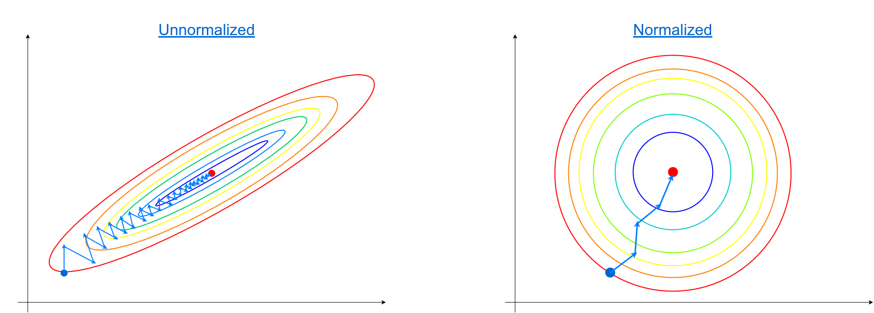
Normalization

Slide 60
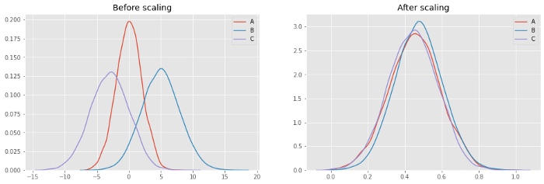
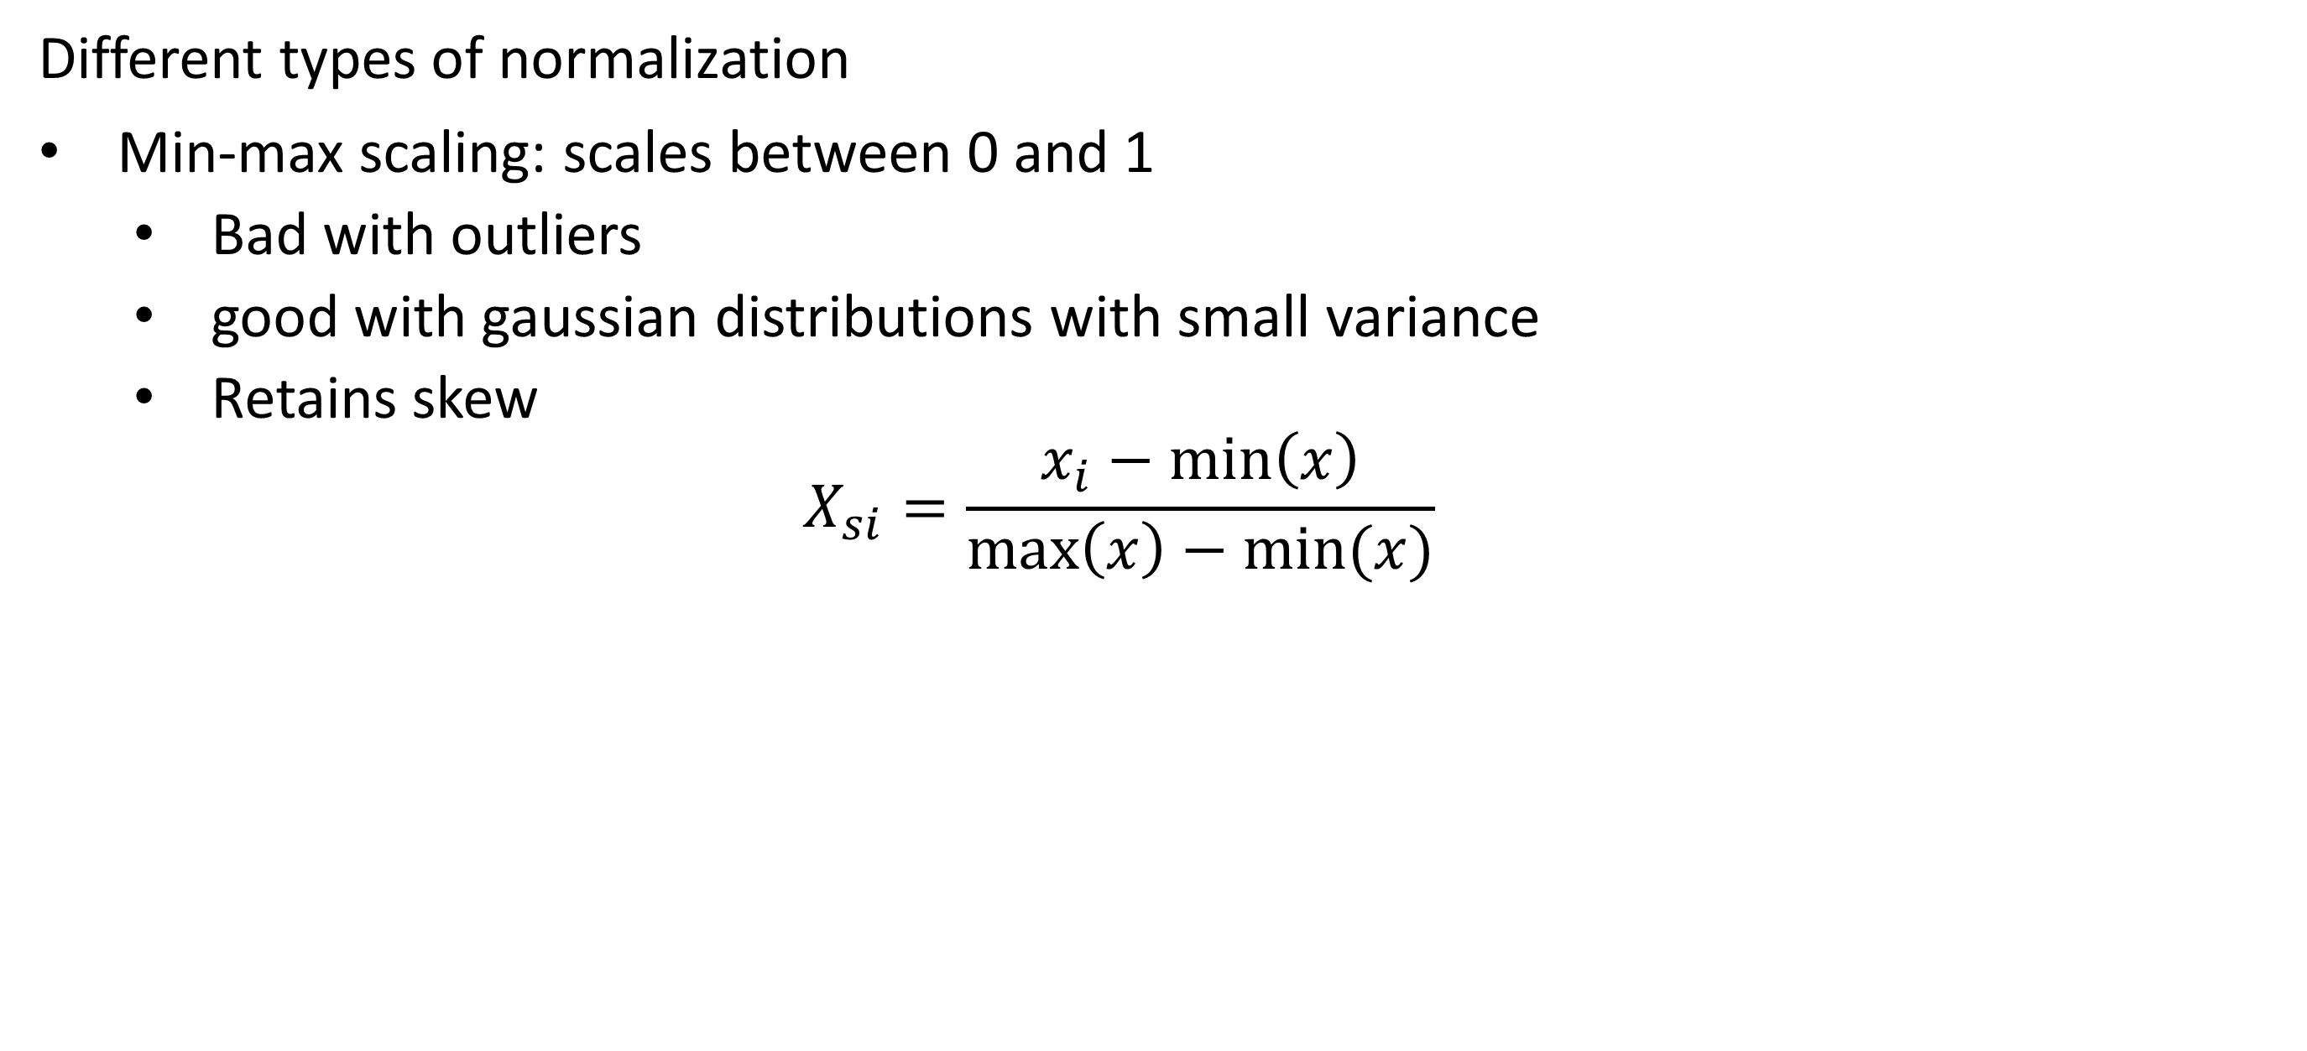
Normalization
Different types of normalization
Min-max scaling: scales between 0 and 1
Bad with outliers
good with gaussian distributions with small variance
Retains skew
$$X_{si}=\frac{x_{i}−\min\left(x\right)}{\max\left(x\right)−min⁡(x)}$$

Slide 61
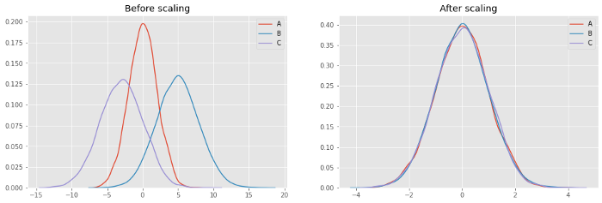
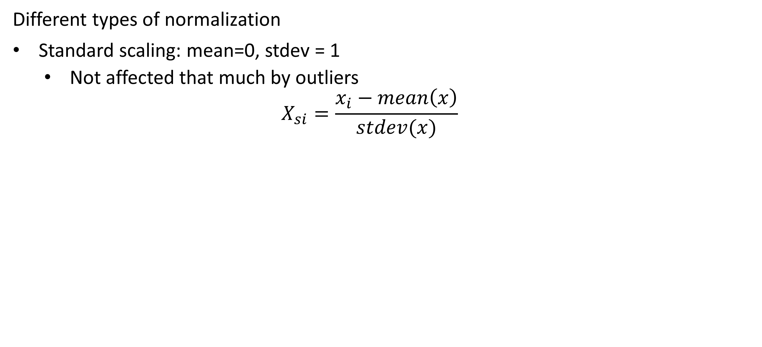
Normalization
Different types of normalization
Standard scaling: mean=0, stdev = 1
Not affected that much by outliers
$$X_{si}=\frac{x_{i}−mean\left(x\right)}{stdev(x)}$$

Slide 62
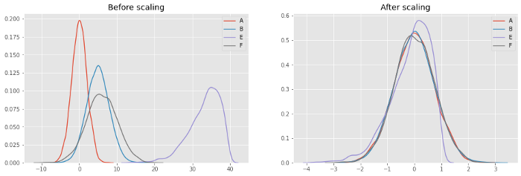
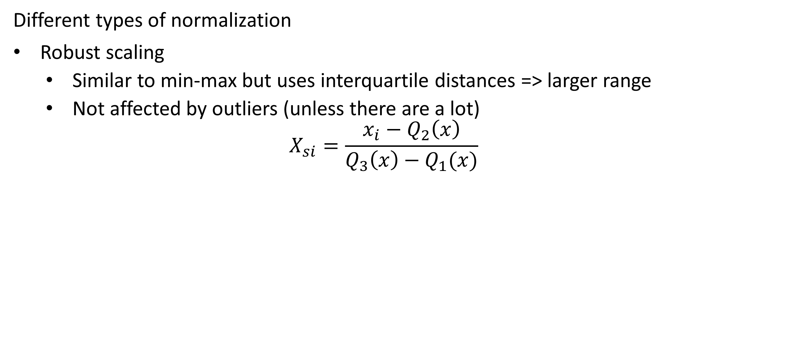
Normalization
Different types of normalization
Robust scaling
Similar to min-max but uses interquartile distances => larger range
Not affected by outliers (unless there are a lot)
$$X_{si}=\frac{x_{i}−Q_{2}\left(x\right)}{Q_{3}\left(x\right)−Q_{1}(x)}$$

Slide 63
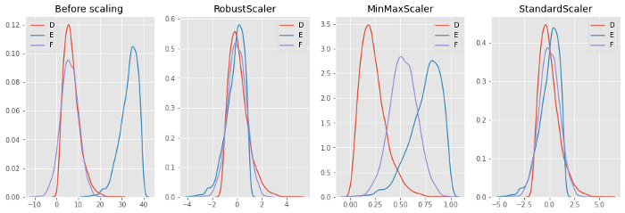
Normalization
Different types of normalization

Slide 64
Normalization
Normalization in code
from sklearn.preprocessing import MinMaxScaler, StandardScaler, RobustScaler
#Depending on the scaler that you want:
scaler=MinMaxScaler()
#scaler=StandardScaler()
#scaler=RobustScaler()
#Scaler.fit will calculate the necessary values (min, max, mean, stdev, Q1,Q2,Q3)
#depending on the chosen scaler. Always on X_train. NEVER on X_test
scaler.fit(X_train)
#Actually transform the data, both X_train and X_test
X_train_scaled = scaler.transform(X_train)
X_test_scaled = scaler.transform(X_test)
print(X_train.values[0])
[1.20829999e-01 0.00000000e+00 2.89000010e+00 4.44999993e-01
8.06900024e+00 7.60000000e+01 3.49519992e+00 2.00000000e+00
2.76000000e+02 1.80000000e+01 3.96899994e+02 4.21000004e+00]
print(X_train_scaled[0])
[0.00168609 0. 0.05728377 0.1234568
0.86376709 0.75283213 0.2470212 0.04347826
0.16826004 0.57446807 1. 0.07926619]

Slide 65
Feature engineering
Feature expansion
Adding new features to the dataset
Adding the surface of a house based on length and width
Getting the distance from a start and end point
Based on the date determining the day of the week
Adding new features that were measured

Slide 66
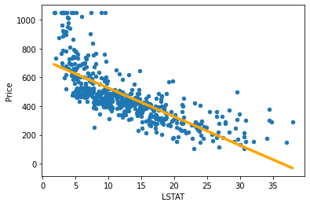
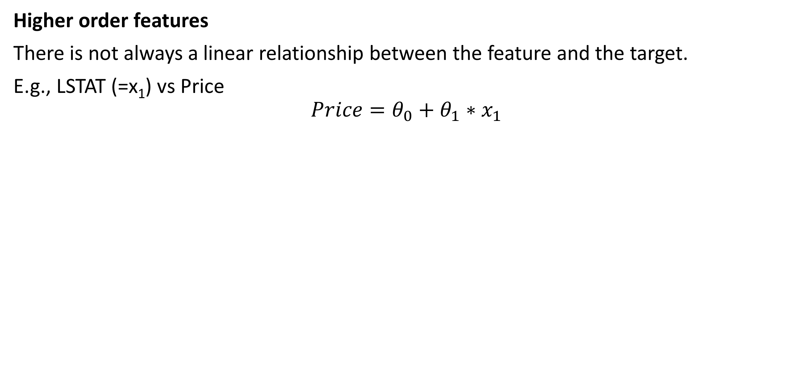
Feature engineering
Higher order features
There is not always a linear relationship between the feature and the target.
E.g., LSTAT (=x₁) vs Price
$$Price=θ_{0}+θ_{1}∗x_{1}$$

Slide 67


Feature engineering
Higher order features
If we add a new feature: LSTAT^2 (=x₂)
$$Price=θ_{0}+θ_{1}∗x_{1}+θ_{2}∗x_{2}$$

Slide 68


Feature engineering
Higher order features
If we add a new feature: LSTAT^3 (=x₃)
$$Price=θ_{0}+θ_{1}∗x_{1}+θ_{2}∗x_{2}+θ_{3}∗x_{3}$$

Slide 69


Feature engineering
Higher order features
Beware of overfitting!
LSTAT + LSTAT^2 + … + LSTAT^12
$$Price=θ_{0}+θ_{1}∗x_{1}+θ_{2}∗x_{2}+…+θ_{12}∗x_{12}$$

Slide 70
Feature engineering
Higher order features
Beware of overfitting!
LSTAT + LSTAT^2 + … + LSTAT^12
$$Price=θ_{0}+θ_{1}∗x_{1}+θ_{2}∗x_{2}+…+θ_{12}∗x_{12}$$

Slide 71
Feature engineering
Higher order features in code
# Adding higher order features: LSTAT^2 and LSTAT^3
# data.insert(index_new_column,name_column,value_column)
data.insert(data.columns.size-1,'LSTAT^2',data.LSTAT**2)
data.insert(data.columns.size-1,'LSTAT^3',data.LSTAT**3)
 | CRIM | ZN | INDUS | NOX | RM | AGE | DIS | RAD | TAX | PT | B | LSTAT | LSTAT^2 | LSTAT^3 | Price
0 | 0,01 | 18,00 | 2,31 | 0,54 | 6,58 | 65,20 | 4,09 | 1,00 | 296,00 | 15,30 | 396,90 | 4,98 | 24,80 | 123,51 | 504,00
1 | 0,03 | 0,00 | 7,07 | 0,47 | 6,42 | 78,90 | 4,97 | 2,00 | 242,00 | 17,80 | 396,90 | 9,14 | 83,54 | 763,55 | 453,60
2 | 0,03 | 0,00 | 7,07 | 0,47 | 7,19 | 61,10 | 4,97 | 2,00 | 242,00 | 17,80 | 392,83 | 4,03 | 16,24 | 65,45 | 728,70
3 | 0,03 | 0,00 | 2,18 | 0,46 | 7,00 | 45,80 | 6,06 | 3,00 | 222,00 | 18,70 | 394,63 | 2,94 | 8,64 | 25,41 | 701,40
4 | 0,07 | 0,00 | 2,18 | 0,46 | 7,15 | 54,20 | 6,06 | 3,00 | 222,00 | 18,70 | 396,90 | 5,33 | 28,41 | 151,42 | 760,20

Slide 72
Feature engineering
One-hot encoding
Change categorical variable into multiple different features
 | Fruit | Price
0 | apple | 5
1 | mango | 10
2 | apple | 15
3 | orange | 20
dataset = pd.concat([dataset,pd.get_dummies(dataset['Fruit'],prefix='Fruit')],axis=1)
dataset.drop(['Fruit'],axis=1,inplace=True)
 | Fruit_apple | Fruit_mango | Fruit_orange | price
0 | 1 | 0 | 0 | 5
1 | 0 | 1 | 0 | 10
2 | 1 | 0 | 0 | 15
3 | 0 | 0 | 1 | 20

Slide 73
Underfitting and overfitting
Underfitting
When the model can’t predict the training and testing data
The model is too simple
The model has a high bias

Slide 74
Underfitting and overfitting
Overfitting
When the model can predict the training data very well, but can’t generalize to the test/real data
The model is too complex
Noise of individual datapoints is picked up
The model has a high variance

Slide 75


Underfitting and overfitting
Overfitting
Depends very much on the training data available
Fewer points: faster overfitting with more complex model

Slide 76


Underfitting and overfitting
Regularization
A way to prevent overfitting (change the bias) of the model
$$J\left(θ\right)=\frac{1}{2m}\sum_{i=1}^{m}{{\left(h_{θ}\left(x^{i}\right)−y^{i}\right)}^{2}+R(θ)}$$
Add an extra term to the cost function. The more features are used, the higher the penalty (and thus the cost). (θ is the bias/slope for each feature)
=> Only use features that are actually helpful to predict the target
$$+ R(θ)$$

Slide 77

Underfitting and overfitting
Regularization
Simplify the formula
$$J\left(θ\right)=\frac{1}{2m}\sum_{i=1}^{m}{{\left(h_{θ}\left(x^{i}\right)−y^{i}\right)}^{2}+R(θ)}$$
$$J_{regularization}=J+R(θ)$$
J

Slide 78

Underfitting and overfitting
Regularization
Two types of regularization depending on R(θ)
$$J_{regularization}=J+R(θ)$$
Ridge regression (L2 regularization)
Lasso regression (L1 regularization)

Slide 79

Underfitting and overfitting
Regularization
Ridge regression (L2)
$$J_{regularization}=J+R(θ)$$
$$with R\left(θ\right)=λ_{2}\sum_{j=1}^{m}{θ_{j}^{2}}$$
λ = The tuning parameter (regulates the allowed complexity)
Lower value of λ: lower bias, higher variance (overfitting)
Higher value of λ: higher bias, lower variance (underfitting)

Slide 80

Underfitting and overfitting
Regularization
Ridge regression (L2)

Slide 81

Underfitting and overfitting
Regularization
Lasso regression (L1)
$$J_{regularization}=J+R(θ)$$
$$with R\left(θ\right)=λ_{1}\sum_{j=1}^{m}{|θ_{j}|}$$
λ = The tuning parameter (regulates the allowed complexity)
Lower value of λ: lower bias, higher variance (overfitting)
Higher value of λ: higher bias, lower variance (underfitting)

Slide 82

Underfitting and overfitting
Regularization
Lasso regression (L1)

Slide 83
Underfitting and overfitting
Regularization in code
Sklearn uses α instead of λ
Lower α = more complex and vice versa
from sklearn.linear_model import Lasso,Ridge
alpha=0.1
# fit_intercept: use a theta0 or not (most cases: True)
Lregmodel = Lasso(alpha=alpha, fit_intercept=True)
Lregmodel.fit(X_train, y_train)
score = Lregmodel.score(X_test,y_test)
Rregmodel = Ridge(alpha=alpha, fit_intercept=True)
Rregmodel.fit(X_train, y_train)
score = Rregmodel.score(X_test,y_test)

